Slide 1
NIELIT SUMMER INTERN 2021
COURSE:
JAVA Programming
NAME:
ASHUTOSH GUPTA
PROJECT NAME:
College_Data_Management_System-by_Ashutosh_Gupta

Slide 2
CODE EDITOR AND LANGUAGES USED :
JAVA Programing using text editor (Sublime Text)
JAVA Program execution in command prompt
JAVA Programing using Eclipse IDE
Use of APPLET in java
APACHE NETBEANS IDE
MYSQL Basics
MYSQL and NETBEANS IDE connection

Slide 3
FEATURES:
It has many features like:-
Login and Registration Page
Registration Page
Data Entry Page
Course Fee Structure Page
Payment Page

Slide 4
DESCRIPTION:
Padma College of Expertise. Provides best teachers all over the world
We are, Padma College of Expertise our one and only goal. To make everyone super special in their interest subjects.
We provides best instruments, best library, best hostel, best food, best Wi-Fi and most importantly best education.

Slide 5
SCREENSHOTS OF THE
DIFFERENT PAGES OF APP

Slide 6
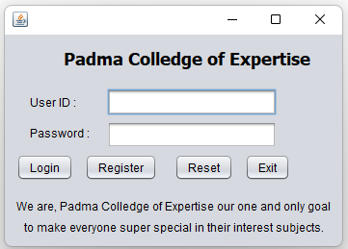
HOME PAGE : (Login and Registration Page)
Click on “Register” to register yourself.

Slide 7
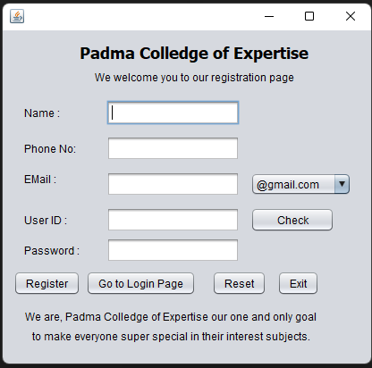
REGISTRATION PAGE: (Registration Page)
Now fill your details.

Slide 8
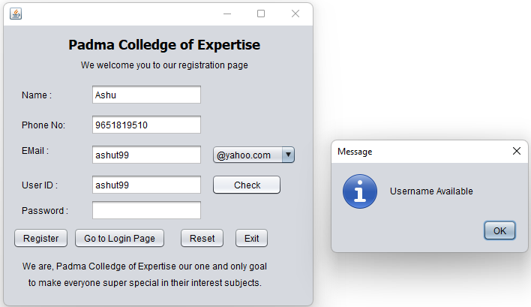
REGISTRATION PAGE: (Registration Page)
Now check “User ID” if Available.

Slide 9
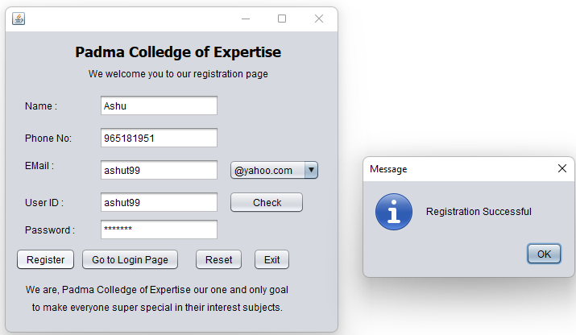
REGISTRATION PAGE: (Registration Page)
Now click “Register” to register yourself.
Login page opens automatically if registration was successful

Slide 10
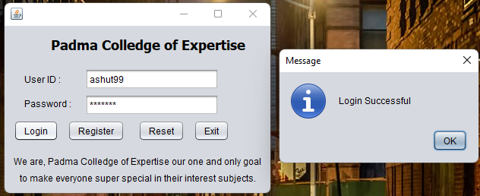
HOME PAGE : (Login and Registration Page)
Now insert your “User ID” and “Password”.
If Login was successful Information entry page opens automatically

Slide 11
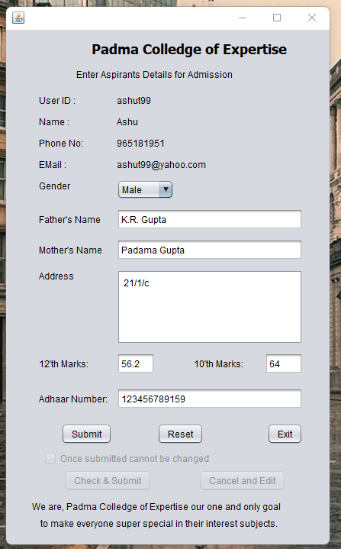
INFORMATION PAGE: (Data Entry Page)
Now insert your data and click on submit.

Slide 12
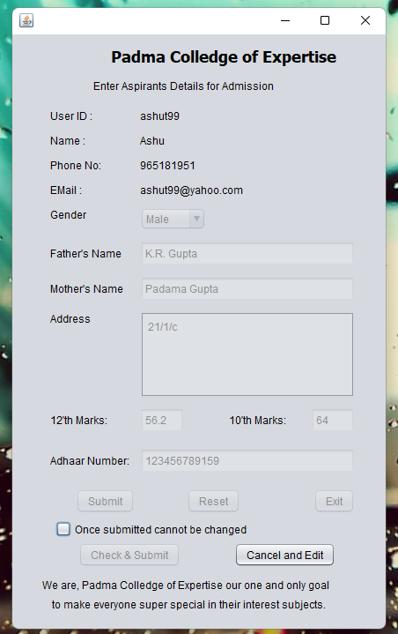
INFORMATION PAGE: (Data Entry Page)
Recheck your data if everything correct thick the checkbox or click on “Cancel and Edit”

Slide 13
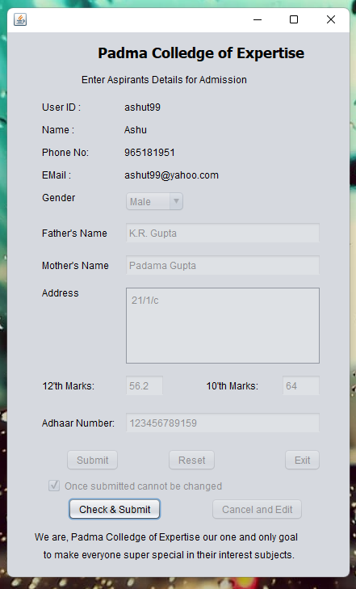
INFORMATION PAGE: (Data Entry Page)
Now Click on Check & Submit it automatically opens Course Fee Page

Slide 14
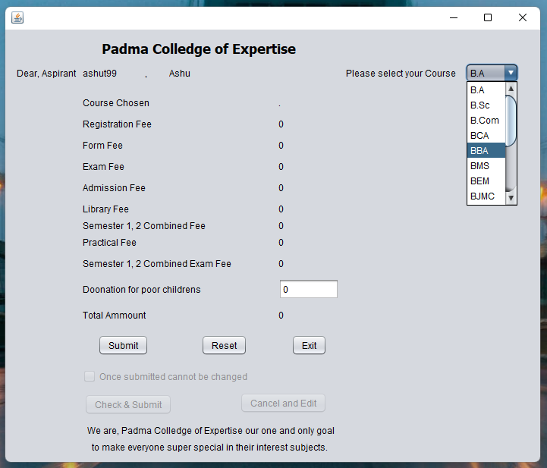
COURSE FEE PAGE: (Course Fee Structure Page)
Now use drop box and make a decision for course and click on submit.

Slide 15
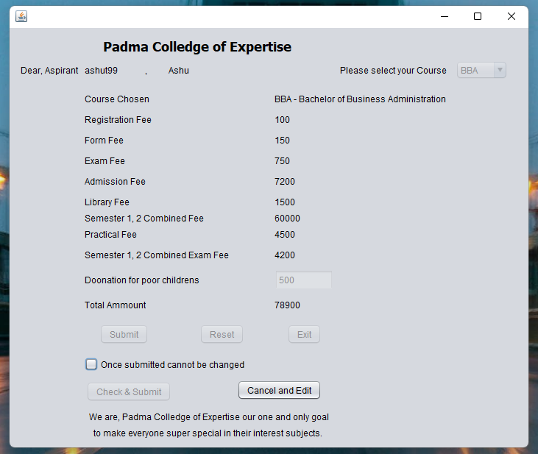
COURSE FEE PAGE: (Course Fee Structure Page)
Recheck your chosen course and donations if everything correct thick the checkbox or click on “Cancel and Edit”

Slide 16
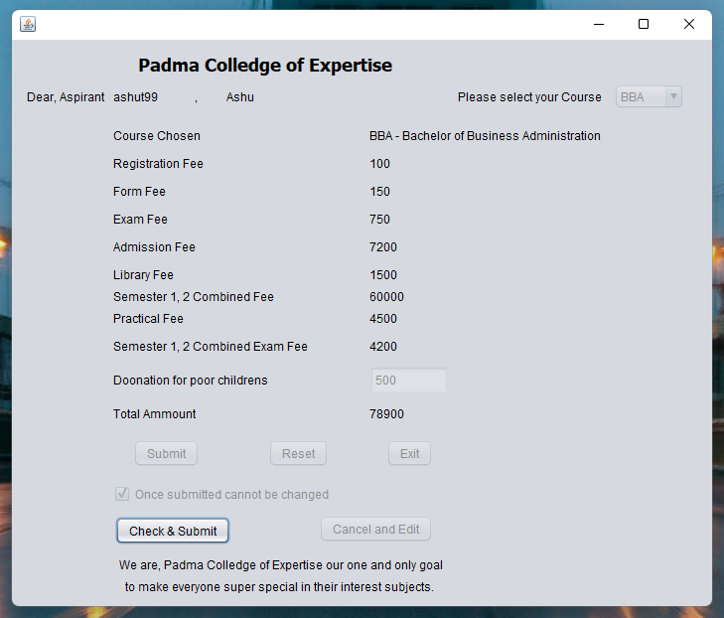
COURSE FEE PAGE: (Course Fee Structure Page)
Now Click on Check & Submit it automatically opens Fee Payment Page

Slide 17
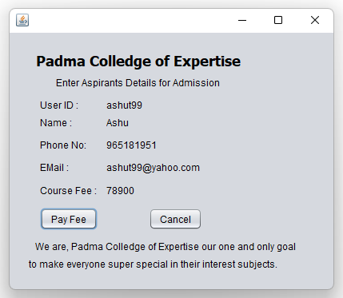
FEE PAYMENT PAGE: (Payment Page)
Now Click on Pay Fee

Slide 18
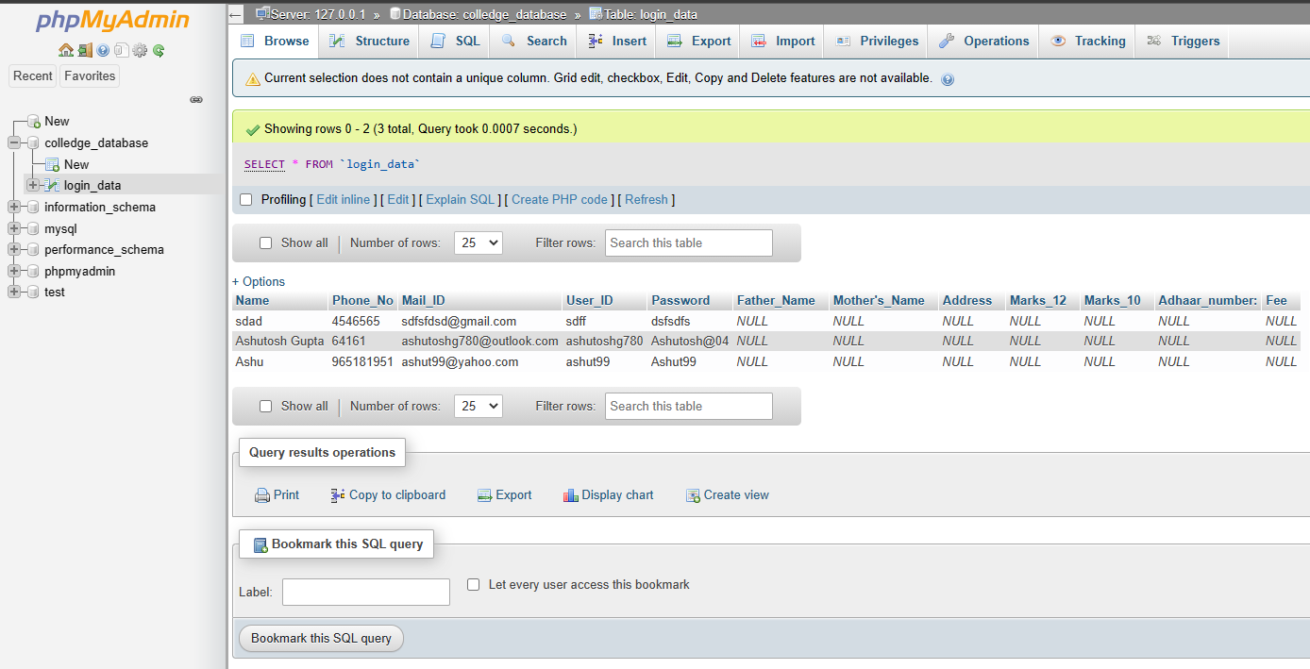
DATABASE INSERTED VALUES:

Slide 19
PROJECT FILES:
PROJECT FILES:
build (Folder)
nbproject (Folder)
src (Folder)
test (Folder)
build (XML Document)
manifest (MF File)
colledge_database (SQL Source File)
colledge_database (XML Documen)

Slide 20
THANK YOU !

